Slide 1


Machine Learning 7. Softmax Regression
Xueyuan Gong
School of Intelligent Systems Science and Engineering

Slide 2
Classification
Binary classification: predicting a binary-valued target
Multiclass classification: predicting a discrete(> 2)-valued target
Examples of multi-class classification
Predict the value of a handwritten digit
classify e-mails as spam, travel, work, personal

Slide 3
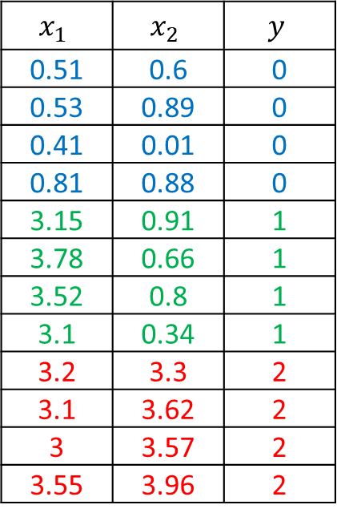
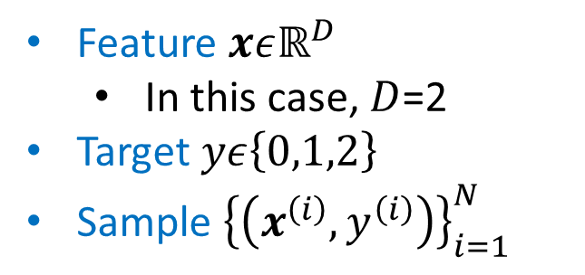
Multi-class classification
Dataset
Feature $xεℝ^{D}$
In this case, $D$=2
Target $yε\left\{0,1,2\right\}$
Sample ${\left\{\left(x^{\left(i\right)},y^{\left(i\right)}\right)\right\}}_{i=1}^{N}$
$$x_{1}$$ | $$x_{2}$$ | $$y$$
0.51 | 0.6 | 0
0.53 | 0.89 | 0
0.41 | 0.01 | 0
0.81 | 0.88 | 0
3.15 | 0.91 | 1
3.78 | 0.66 | 1
3.52 | 0.8 | 1
3.1 | 0.34 | 1
3.2 | 3.3 | 2
3.1 | 3.62 | 2
3 | 3.57 | 2
3.55 | 3.96 | 2

Slide 4
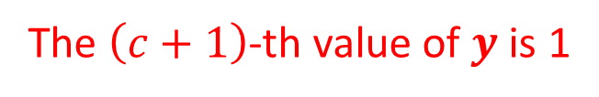
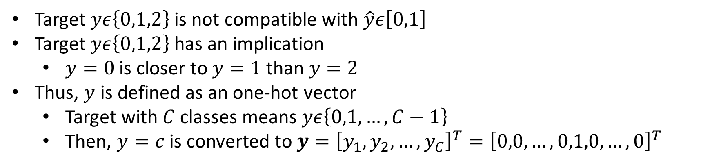
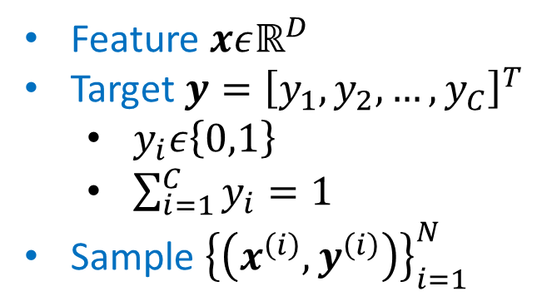
One-hot Vector
Target $yε\left\{0,1,2\right\}$ is not compatible with $\hat{y}ε\left[0,1\right]$
Target $yε\left\{0,1,2\right\}$ has an implication
$y=0$ is closer to $y=1$ than $y=2$
Thus, $y$ is defined as an one-hot vector
Target with $C$ classes means $yε\left\{0,1,…,C−1\right\}$
Then, $y=c$ is converted to $y={\left[y_{1},y_{2},…,y_{C}\right]}^{T}={\left[0,0,…,0,1,0,…,0\right]}^{T}$
Feature $xεℝ^{D}$
Target $y={\left[y_{1},y_{2},…,y_{C}\right]}^{T}$
$y_{i}ε\left\{0,1\right\}$
$\sum_{i=1}^{C}{y_{i}}=1$
Sample ${\left\{\left(x^{\left(i\right)},y^{\left(i\right)}\right)\right\}}_{i=1}^{N}$
The $\left(c+1\right)$-th value of $y$ is 1

Slide 5
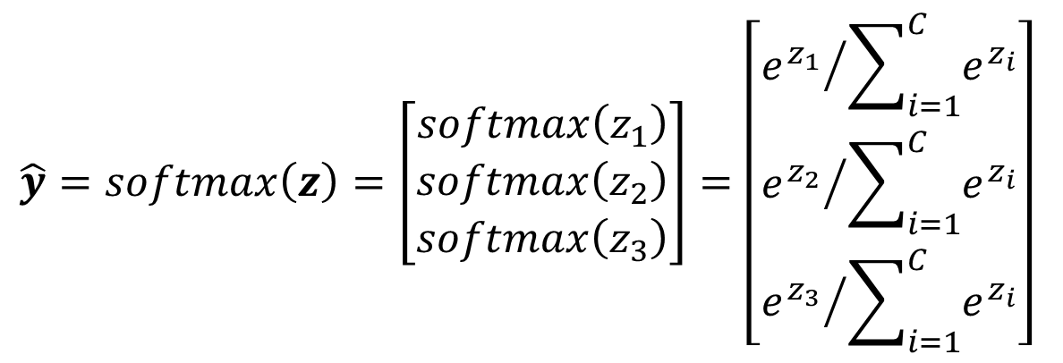
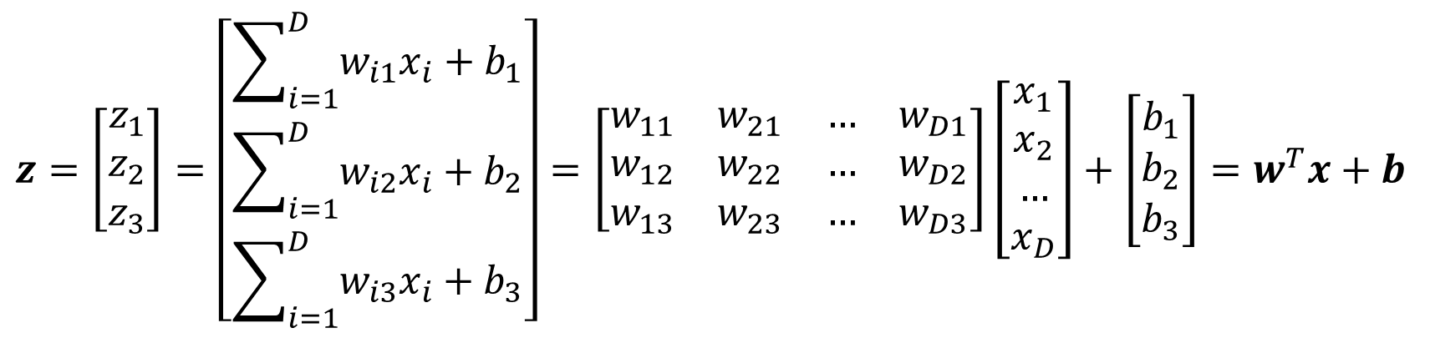
Softmax Regression
Model
$$z=\left[\begin{matrix}z_{1} \\ z_{2} \\ z_{3}\end{matrix}\right]=\left[\begin{matrix}\sum_{i=1}^{D}{w_{i1}x_{i}+b_{1}} \\ \sum_{i=1}^{D}{w_{i2}x_{i}+b_{2}} \\ \sum_{i=1}^{D}{w_{i3}x_{i}+b_{3}}\end{matrix}\right]=\left[\begin{matrix}w_{11} & w_{21} & … & w_{D1} \\ w_{12} & w_{22} & … & w_{D2} \\ w_{13} & w_{23} & … & w_{D3}\end{matrix}\right]\left[\begin{matrix}x_{1} \\ x_{2} \\ … \\ x_{D}\end{matrix}\right]+\left[\begin{matrix}b_{1} \\ b_{2} \\ b_{3}\end{matrix}\right]=w^{T}x+b$$
$$\hat{y}=softmax\left(z\right)=\left[\begin{matrix}softmax\left(z_{1}\right) \\ softmax\left(z_{2}\right) \\ softmax\left(z_{3}\right)\end{matrix}\right]=\left[\begin{matrix}{e^{z_{1}}}/{\sum_{i=1}^{C}{e^{z_{i}}}} \\ {e^{z_{2}}}/{\sum_{i=1}^{C}{e^{z_{i}}}} \\ {e^{z_{3}}}/{\sum_{i=1}^{C}{e^{z_{i}}}}\end{matrix}\right]$$

Slide 6
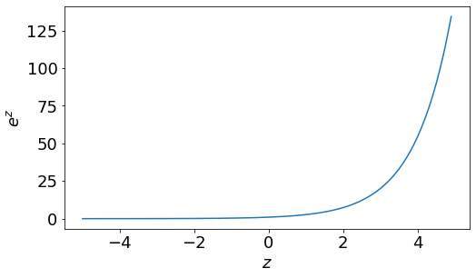
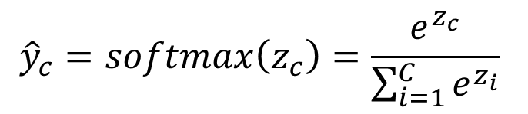
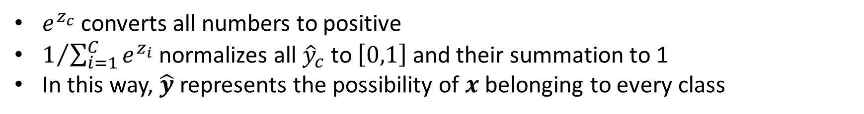
Softmax Function
$${\hat{y}}_{c}=softmax\left(z_{c}\right)=\frac{e^{z_{c}}}{\sum_{i=1}^{C}{e^{z_{i}}}}$$
$e^{z_{c}}$ converts all numbers to positive
$1/{\sum_{i=1}^{C}{e^{z_{i}}}}$ normalizes all ${\hat{y}}_{c}$ to $\left[0,1\right]$ and their summation to 1
In this way, $\hat{y}$ represents the possibility of $x$ belonging to every class

Slide 7

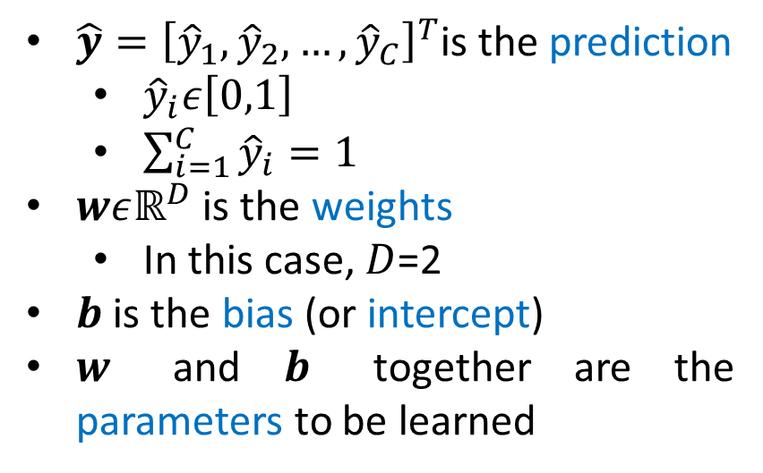
Softmax Regression
Model
$$\hat{y}=Softmax\left(z\right)=Softmax\left(w^{T}x+b\right)$$
$\hat{y}{=\left[{\hat{y}}_{1},{\hat{y}}_{2},…,{\hat{y}}_{C}\right]}^{T}$is the prediction
${\hat{y}}_{i}ε\left[0,1\right]$
$\sum_{i=1}^{C}{{\hat{y}}_{i}}=1$
$wεℝ^{D}$ is the weights
In this case, $D$=2
$b$ is the bias (or intercept)
$w$ and $b$ together are the parameters to be learned

Slide 8
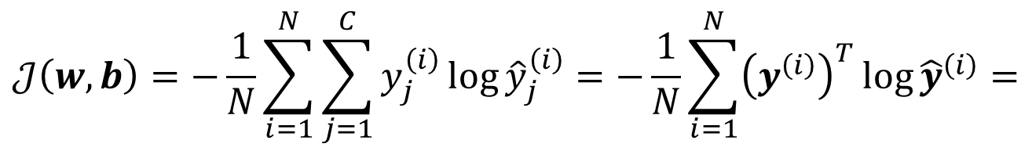
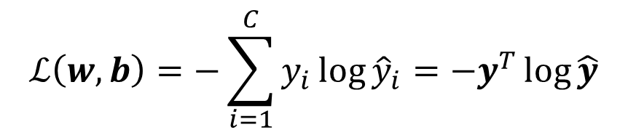
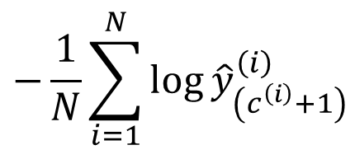

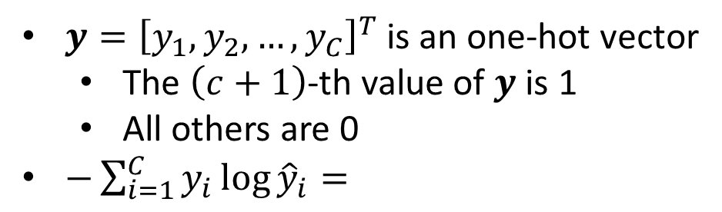
Cost Function
Loss Function
$y{=\left[y_{1},y_{2},…,y_{C}\right]}^{T}$ is an one-hot vector
The $\left(c+1\right)$-th value of $y$ is 1
All others are 0
$−\sum_{i=1}^{C}{y_{i}\log{{\hat{y}}_{i}}}=$
$$ℒ\left(w,b\right)=−\sum_{i=1}^{C}{y_{i}\log{{\hat{y}}_{i}}}=−y^{T}\log{\hat{y}}$$
$$−\log{{\hat{y}}_{\left(c+1\right)}}$$
Cost Function
$$𝒥\left(w,b\right)=−\frac{1}{N}\sum_{i=1}^{N}{\sum_{j=1}^{C}{y_{j}^{\left(i\right)}\log{{\hat{y}}_{j}^{\left(i\right)}}}}=−\frac{1}{N}\sum_{i=1}^{N}{{\left(y^{\left(i\right)}\right)}^{T}\log{{\hat{y}}^{\left(i\right)}}}=$$
$$−\frac{1}{N}\sum_{i=1}^{N}{\log{{\hat{y}}_{\left(c^{\left(i\right)}+1\right)}^{\left(i\right)}}}$$
$ℒ\left(w,b\right)$ is called Cross Entropy, which is equivalent to Binary Cross Entropy

Slide 9



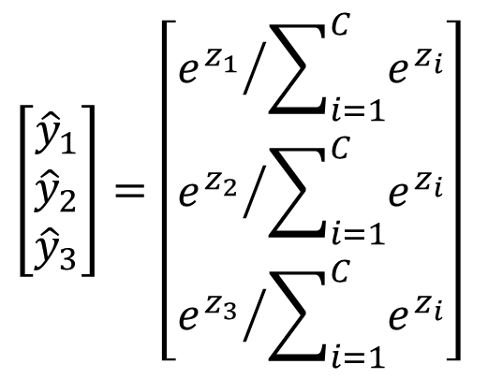



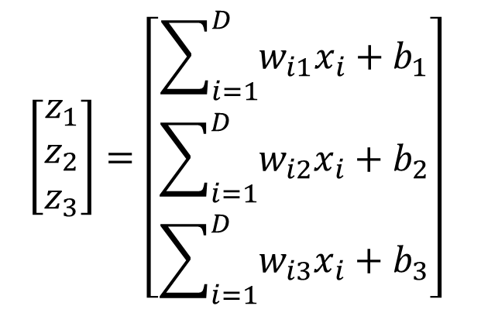

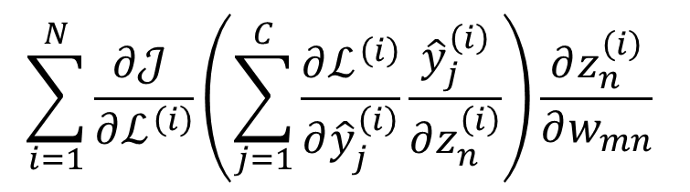

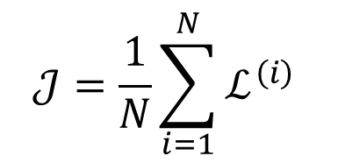



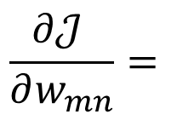
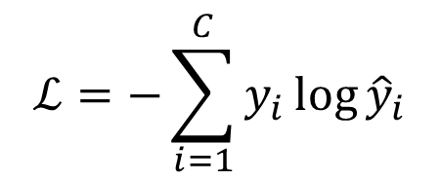


Gradient Descent
$$…$$
$$ℒ^{\left(1\right)}$$
Model
$$…$$
$$…$$
$$\left[\begin{matrix}z_{1} \\ z_{2} \\ z_{3}\end{matrix}\right]=\left[\begin{matrix}\sum_{i=1}^{D}{w_{i1}x_{i}+b_{1}} \\ \sum_{i=1}^{D}{w_{i2}x_{i}+b_{2}} \\ \sum_{i=1}^{D}{w_{i3}x_{i}+b_{3}}\end{matrix}\right]$$
$$\left[\begin{matrix}{\hat{y}}_{1} \\ {\hat{y}}_{2} \\ {\hat{y}}_{3}\end{matrix}\right]=\left[\begin{matrix}{e^{z_{1}}}/{\sum_{i=1}^{C}{e^{z_{i}}}} \\ {e^{z_{2}}}/{\sum_{i=1}^{C}{e^{z_{i}}}} \\ {e^{z_{3}}}/{\sum_{i=1}^{C}{e^{z_{i}}}}\end{matrix}\right]$$
$${\hat{y}}_{1}^{\left(i\right)}$$
$$w_{mn}$$
$$z_{n}^{\left(i\right)}$$
$${\hat{y}}_{2}^{\left(i\right)}$$
$$ℒ^{\left(i\right)}$$
$$𝒥$$
$${\hat{y}}_{3}^{\left(i\right)}$$
$$…$$
$$…$$
$$ℒ=−\sum_{i=1}^{C}{y_{i}\log{{\hat{y}}_{i}}}$$
$$…$$
$$ℒ^{\left(N\right)}$$
$$\sum_{i=1}^{N}{\frac{∂𝒥 }{∂ℒ^{\left(i\right)}}\left(\sum_{j=1}^{C}{\frac{∂ℒ^{\left(i\right)}}{∂{\hat{y}}_{j}^{\left(i\right)}}\frac{{\hat{y}}_{j}^{\left(i\right)}}{∂z_{n}^{\left(i\right)}}}\right)\frac{∂z_{n}^{\left(i\right)}}{∂w_{mn}}}$$
$$𝒥=\frac{1}{N}\sum_{i=1}^{N}{ℒ^{\left(i\right)}}$$
$$\frac{∂𝒥 }{∂w_{mn}}=$$

Slide 10
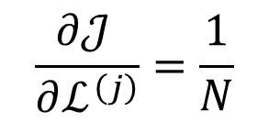
Back Propagation
$$ℒ^{\left(1\right)}$$
$$…$$
$$𝒥=\frac{1}{N}\sum_{i=1}^{N}{ℒ^{\left(i\right)}}$$
$$ℒ^{\left(i\right)}$$
$$𝒥$$
$$\frac{∂𝒥 }{∂ℒ^{\left(j\right)}}=\frac{1}{N}$$
$$…$$
$$ℒ^{\left(N\right)}$$

Slide 11
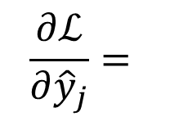
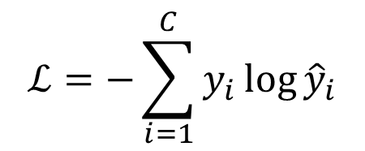




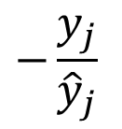
Back Propagation
$$ℒ=−\sum_{i=1}^{C}{y_{i}\log{{\hat{y}}_{i}}}$$
$${\hat{y}}_{1}$$
$${\hat{y}}_{2}$$
$$ℒ$$
$$\frac{∂ℒ}{∂{\hat{y}}_{j}}=$$
$$−\frac{y_{j}}{{\hat{y}}_{j}}$$
$${\hat{y}}_{3}$$

Slide 12
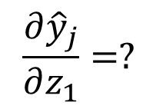

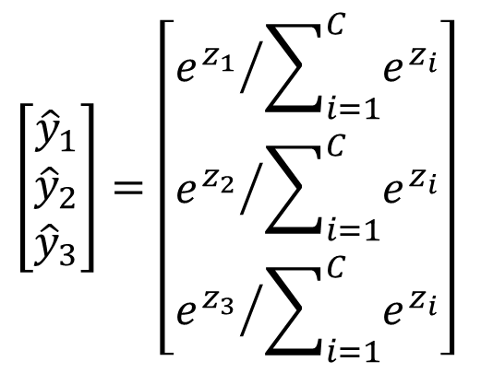






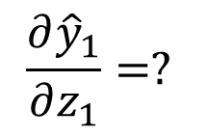
Back Propagation
$$\left[\begin{matrix}{\hat{y}}_{1} \\ {\hat{y}}_{2} \\ {\hat{y}}_{3}\end{matrix}\right]=\left[\begin{matrix}{e^{z_{1}}}/{\sum_{i=1}^{C}{e^{z_{i}}}} \\ {e^{z_{2}}}/{\sum_{i=1}^{C}{e^{z_{i}}}} \\ {e^{z_{3}}}/{\sum_{i=1}^{C}{e^{z_{i}}}}\end{matrix}\right]$$
$$z_{1}$$
$${\hat{y}}_{1}$$
$$z_{2}$$
$${\hat{y}}_{2}$$
$$z_{3}$$
$${\hat{y}}_{3}$$
$$\frac{{∂\hat{y}}_{1}}{∂z_{1}}=?$$
$$j≠1$$
$$\frac{{∂\hat{y}}_{j}}{∂z_{1}}=?$$

Slide 13
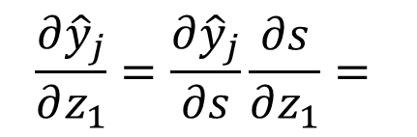

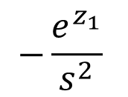




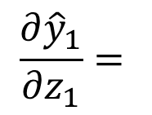
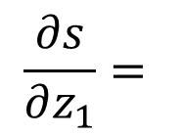
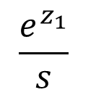


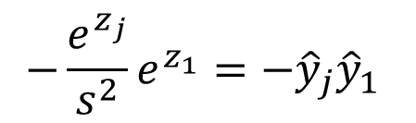

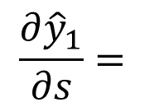
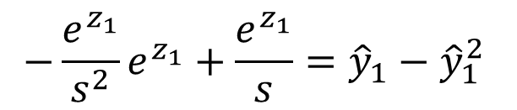



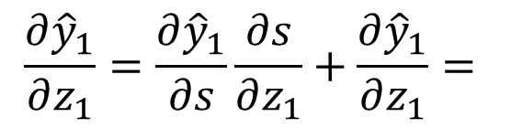
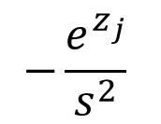
Back Propagation
$$\frac{∂{\hat{y}}_{1}}{∂s}=$$
$$−\frac{e^{z_{1}}}{s^{2}}$$
$$\frac{∂{\hat{y}}_{j}}{∂s}=$$
$$−\frac{e^{z_{j}}}{s^{2}}$$
$$s=e^{z_{1}}+e^{z_{2}}+e^{z_{3}}$$
$${\hat{y}}_{1}={e^{z_{1}}}/s$$
$$\frac{∂s}{∂z_{1}}=$$
$$e^{z_{1}}$$
$${\hat{y}}_{1}$$
$${\hat{y}}_{2}={e^{z_{2}}}/s$$
$$z_{1}$$
$$s$$
$${\hat{y}}_{2}$$
$${\hat{y}}_{3}={e^{z_{3}}}/s$$
$$\frac{{∂\hat{y}}_{1}}{∂z_{1}}=$$
$$\frac{e^{z_{1}}}{s}$$
$${\hat{y}}_{3}$$
$$\frac{{∂\hat{y}}_{1}}{∂z_{1}}=\frac{∂{\hat{y}}_{1}}{∂s}\frac{∂s}{∂z_{1}}+\frac{{∂\hat{y}}_{1}}{∂z_{1}}=$$
$$−\frac{e^{z_{1}}}{s^{2}}e^{z_{1}}+\frac{e^{z_{1}}}{s}={\hat{y}}_{1}−{\hat{y}}_{1}^{2}$$
$$j≠1$$
$$\frac{{∂\hat{y}}_{j}}{∂z_{1}}=\frac{∂{\hat{y}}_{j}}{∂s}\frac{∂s}{∂z_{1}}=$$
$$−\frac{e^{z_{j}}}{s^{2}}e^{z_{1}}=−{\hat{y}}_{j}{\hat{y}}_{1}$$

Slide 14
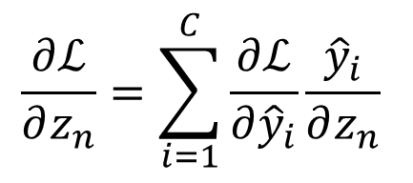

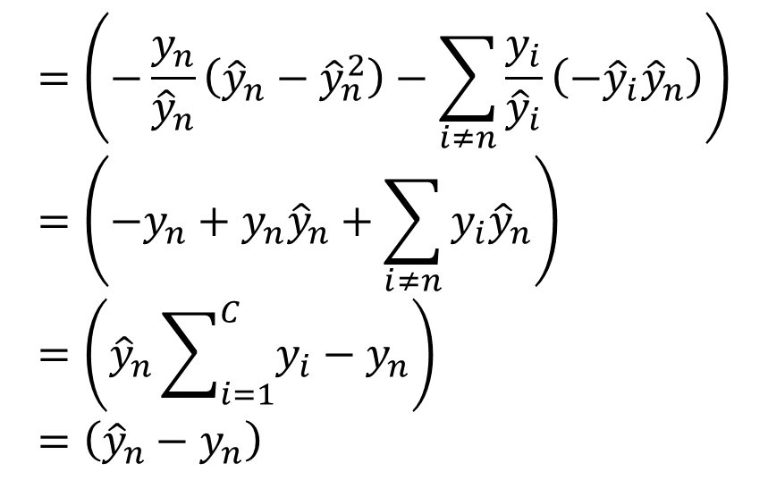
Back Propagation
$$\frac{∂ℒ}{∂z_{n}}=\sum_{i=1}^{C}{\frac{∂ℒ}{∂{\hat{y}}_{i}}\frac{{\hat{y}}_{i}}{∂z_{n}}}$$
$${\hat{y}}_{1}$$
$$=\left(−\frac{y_{n}}{{\hat{y}}_{n}}\left({\hat{y}}_{n}−{\hat{y}}_{n}^{2}\right)−\sum_{i≠n}{\frac{y_{i}}{{\hat{y}}_{i}}\left(−{\hat{y}}_{i}{\hat{y}}_{n}\right)}\right)=\left(−y_{n}+y_{n}{\hat{y}}_{n}+\sum_{i≠n}{y_{i}{\hat{y}}_{n}}\right)=\left({\hat{y}}_{n}\sum_{i=1}^{C}{y_{i}}−y_{n}\right)=\left({\hat{y}}_{n}−y_{n}\right)$$
$$z_{n}$$
$${\hat{y}}_{2}$$
$$ℒ$$
$${\hat{y}}_{3}$$

Slide 15

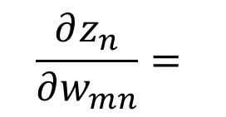


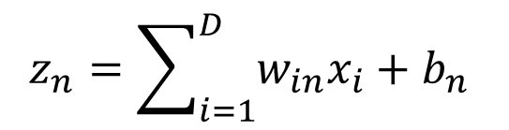







Back Propagation
$$\left[\begin{matrix}z_{1} \\ z_{2} \\ z_{3}\end{matrix}\right]=\left[\begin{matrix}\sum_{i=1}^{D}{w_{i1}x_{i}+b_{1}} \\ \sum_{i=1}^{D}{w_{i2}x_{i}+b_{2}} \\ \sum_{i=1}^{D}{w_{i3}x_{i}+b_{3}}\end{matrix}\right]$$
$$w_{m1}$$
$$z_{1}$$
$$z_{n}=\sum_{i=1}^{D}{w_{in}x_{i}+b_{n}}$$
$$w_{m2}$$
$$z_{2}$$
$$w_{mn}$$
$$z_{n}$$
$$w_{m3}$$
$$z_{3}$$
$$\frac{∂z_{n}}{∂w_{mn}}=$$
$$x_{m}$$

Slide 16
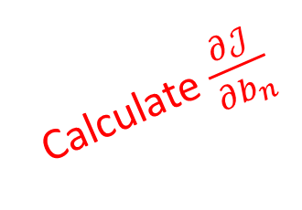
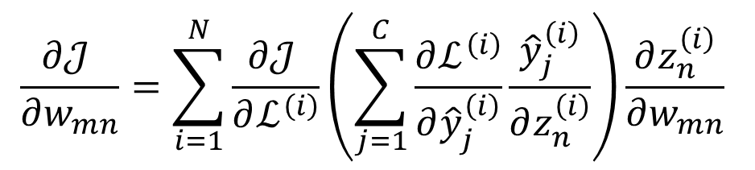
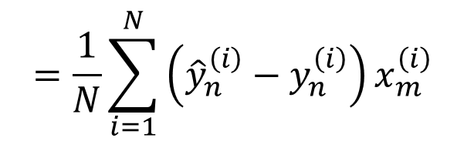



Gradient Descent
$$\frac{∂𝒥 }{∂w_{mn}}=\sum_{i=1}^{N}{\frac{∂𝒥 }{∂ℒ^{\left(i\right)}}\left(\sum_{j=1}^{C}{\frac{∂ℒ^{\left(i\right)}}{∂{\hat{y}}_{j}^{\left(i\right)}}\frac{{\hat{y}}_{j}^{\left(i\right)}}{∂z_{n}^{\left(i\right)}}}\right)\frac{∂z_{n}^{\left(i\right)}}{∂w_{mn}}}$$
$$\frac{∂𝒥 }{∂ℒ^{\left(i\right)}}=\frac{1}{N}$$
$$\frac{∂ℒ}{∂z_{n}}=\sum_{j=1}^{C}{\frac{∂ℒ}{∂{\hat{y}}_{j}}\frac{{\hat{y}}_{j}}{∂z_{n}}}=\left({\hat{y}}_{n}−y_{n}\right)$$
$$=\frac{1}{N}\sum_{i=1}^{N}{\left({\hat{y}}_{n}^{\left(i\right)}−y_{n}^{\left(i\right)}\right)x_{m}^{\left(i\right)}}$$
$$\frac{∂z_{n}}{∂w_{mn}}=x_{m}$$
Calculate $\frac{∂𝒥}{∂b_{n}}$

Slide 17








Summary
Model
$$𝒥=\frac{1}{N}\sum_{i=1}^{N}{ℒ^{\left(i\right)}}$$
$$z^{\left(i\right)}=w^{T}x^{\left(i\right)}+b$$
$${\hat{y}}^{\left(i\right)}=Softmax\left(z^{\left(i\right)}\right)$$
$$ℒ^{\left(i\right)}=−{\left(y^{\left(i\right)}\right)}^{T}\log{{\hat{y}}^{\left(i\right)}}$$
Calculate Gradient
$$\frac{∂𝒥 }{∂w_{mn}}=\frac{1}{N}\sum_{i=1}^{N}{\left({\hat{y}}_{n}^{\left(i\right)}−y_{n}^{\left(i\right)}\right)x_{m}^{\left(i\right)}}$$
$$\frac{∂𝒥 }{∂b_{n}}=\frac{1}{N}\sum_{i=1}^{N}{\left({\hat{y}}_{n}^{\left(i\right)}−y_{n}^{\left(i\right)}\right)}$$
Update
$$w_{mn}=w_{mn}−α\frac{∂𝒥}{∂w_{mn}}=w_{mn}−\frac{α}{N}\sum_{i=1}^{N}{\left({\hat{y}}_{n}^{\left(i\right)}−y_{n}^{\left(i\right)}\right)x_{m}^{\left(i\right)}}$$
$$b_{n}=b_{n}−α\frac{∂𝒥}{∂b_{n}}=b_{n}−\frac{α}{N}\sum_{i=1}^{N}{\left({\hat{y}}_{n}^{\left(i\right)}−y_{n}^{\left(i\right)}\right)}$$

Slide 18

*K Nearest Neighbors
There are also other classification methods
K Nearest Neighbors (KNN) is an easy one
Given a test sample $x$
Count its K nearest neighbors
Then $x$ belongs to the class that most neighbors belong to

Slide 19
Thank you！

